Slide 1
Usability Test Report of BeeHappy
Germany Task Group

Slide 2
Executive Summary
Test:
We made 5 formal usability tests in total (excluding the pilot test).
Method of test:
We mostly followed our test script with some additional questions depending on the situation of each test. We got the agreement of all our five participants on the content form.

Slide 3
Analysis and Findings:
1. Surprising reflection are found from users on problematic parts that the developers never thought of
2. People with similar experience still have very different problems
3. Not all problems reflected are supposed to be changed
4. Content of prototype will influence the experience of users very much

Slide 4
Main Problems and Implication:
1. Icons can be more explicit in its meaning, and some can be more explicit as clickable buttons
2. The layout of some pages makes it hard to read. It can be improved by the change of layout.
3. The real experiences can be modeled better by changing the example content in the prototype

Slide 5
Research method
We have five participants who are all university students.
All participants have done formal tests.
They are three male and two female students among our participants.
All of the participants are aged from 20 to 25.
Most of the participants are iPhone users. (4 iPhone and 1 Android)
Most of the participants use a lot of social media application.

Slide 6
Task list
The tasks we assigned to our participants include two main tasks and a couple of sub-tasks
Two main task:
1. From “register” to “post one post” to “one of most popular topics”
2. From “log in” to “reply to one of the comments I post before”

Slide 7
Sub-tasks
Go to post page
Change background at post page
Change your post from public to secret
Find your secret post
Etc.

Slide 8
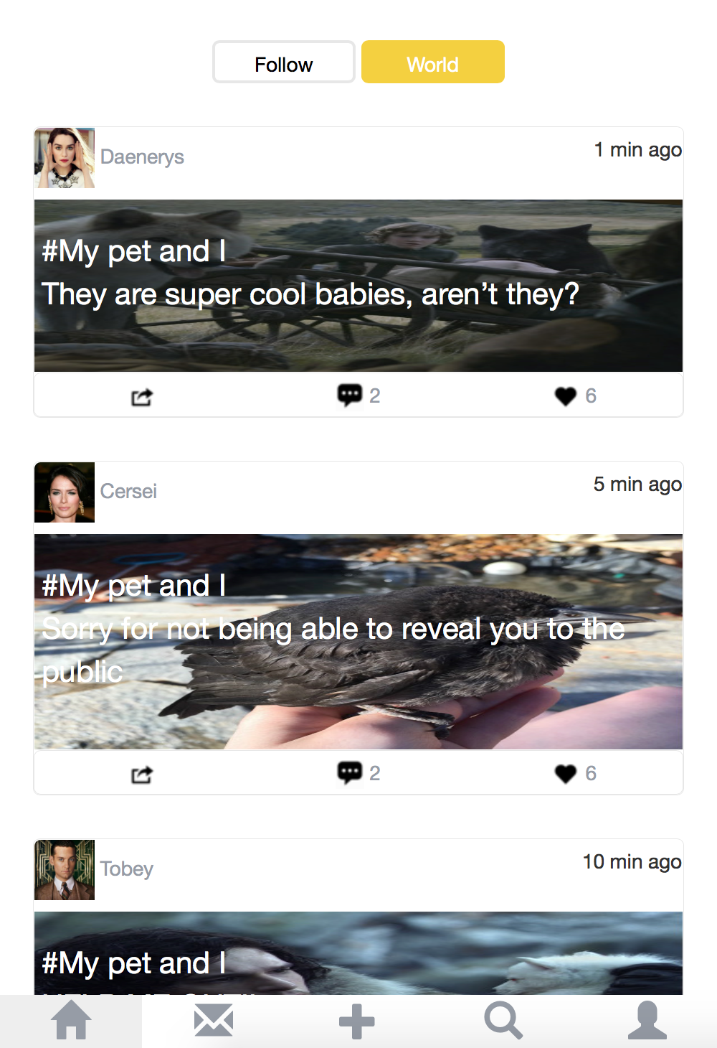
Analysis & Findings
What works well
The switch between different pages is smooth. In our observations, most of our participants can easily find the approach to get to the pages they expected under the indicated scenarios.
We think it is because we took advantage of the knowledge our users already gained in their previous experiences with social media. In the navigation bar, we choose some icons that are commonly used in many popular social media.

Slide 9
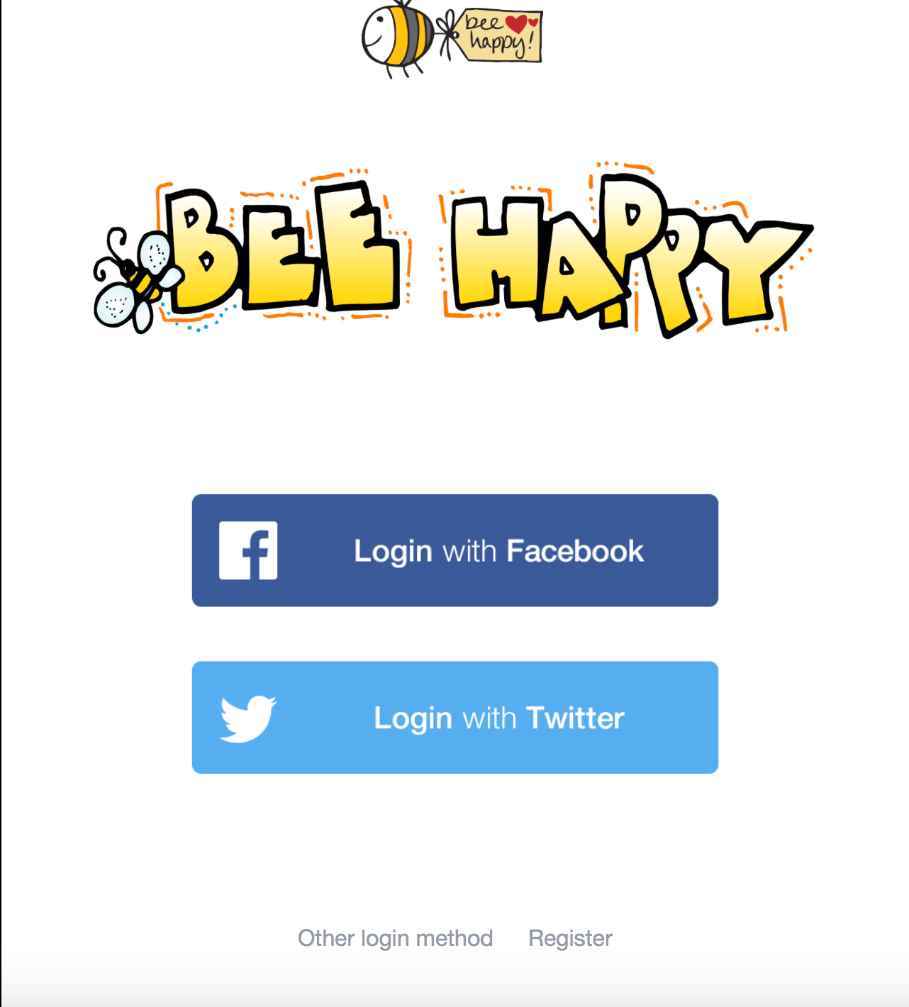
Login&Register button Issue(Low)
Finding: The “other login method” and“Register” button is not obvious.
Most Users click on the Facebook or Twitter button first. They didn't recognize them at the first time.

Slide 10

Supporting evidence
Participant A:“Maybe Facebook right. Oh! There have other buttons here.So assume I was using this app, I will use other method.”
Participant B“It’s hard to find these icons.There seem to be only 2 icons on this page. I don’t know what I can do if you don’t allow me to log in with Facebook.”
audio
Recommendation
Make those buttons bigger or change the color to make it more obvious comparing to the background. Also, thinking of switch the position with Facebook and Twitter.

Slide 11
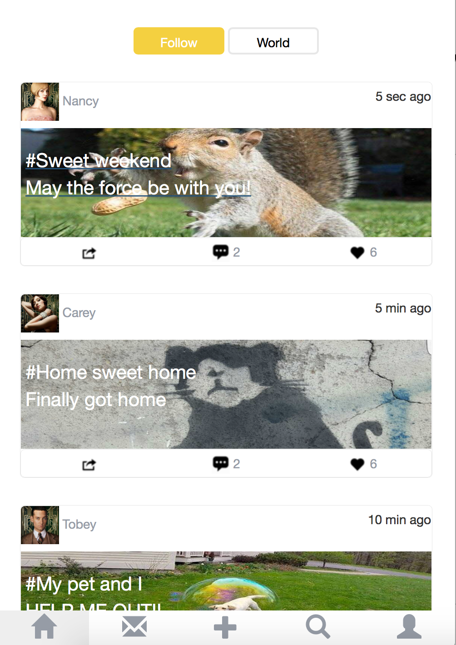
Follow and world icon Issue(Medium)
Finding:Using the word ”Follow” is ambiguous to indicate that it’s the page about the posts of who the user is following.
Users are confused about the follow on the top, and treat it as a function for following other users.But after trying the follow and world button, users understand the concept.

Slide 12
Supporting evidence
Participant A:“Oh, ok. Is this the people I am following right now, and that page(The World page) is I don’t follow but you guys recommend. I think you should use the word following because these people are already followed by me. So it doesn’t make sense for just saying follow.”
Participant B:audio
Recommendation
Change the word to “following” maybe make it less ambiguous.

Slide 13
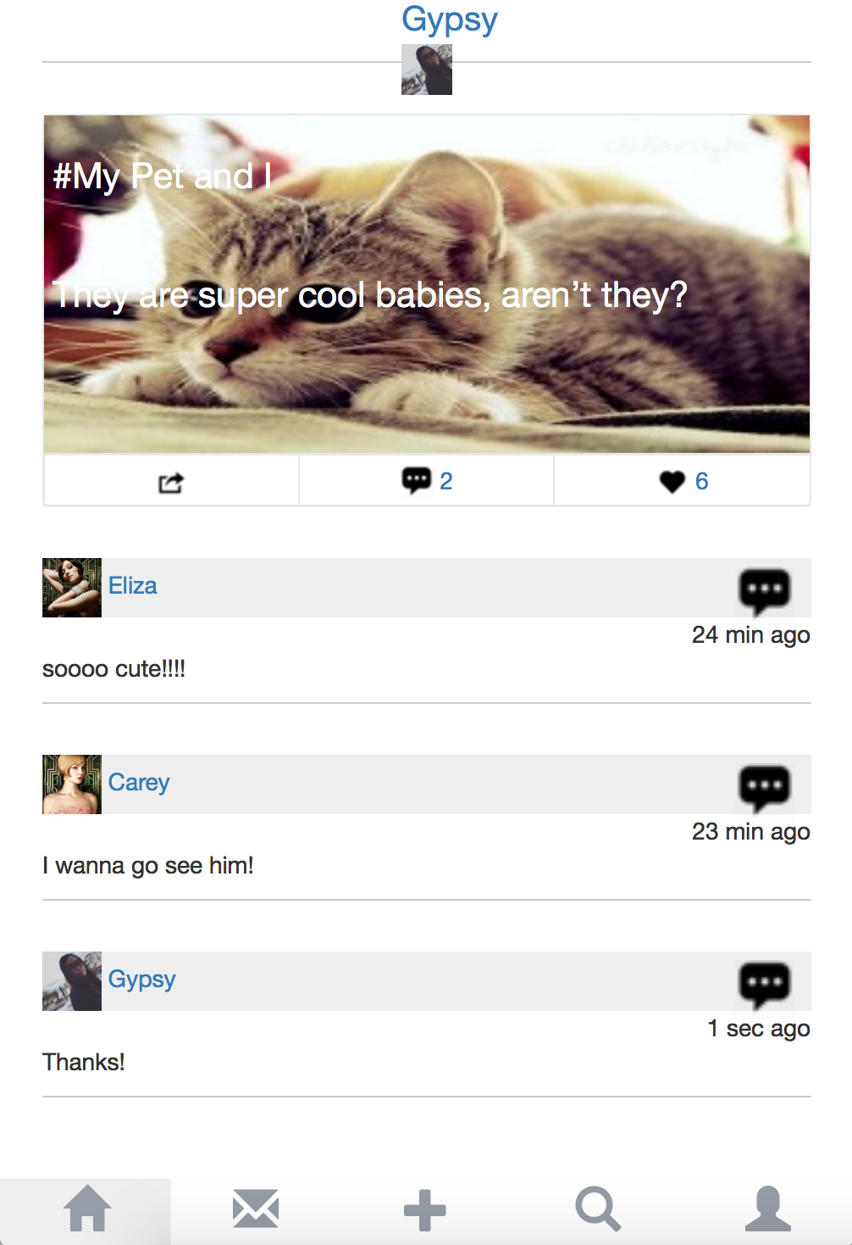
Reply Issue(Medium)
Finding:User’s reply isn’t clear. Hard to tell who is the one you are replying to.
After replying to a comment, user found that the reply doesn’t show the user who he is replying to.

Slide 14
Supporting evidence
Participant A:“If I come back later I won’t be able to remember who I replied to, and all my replies will make no sense”
Recommendation
Adding a @someone to indicate who you are replying to.

Slide 15
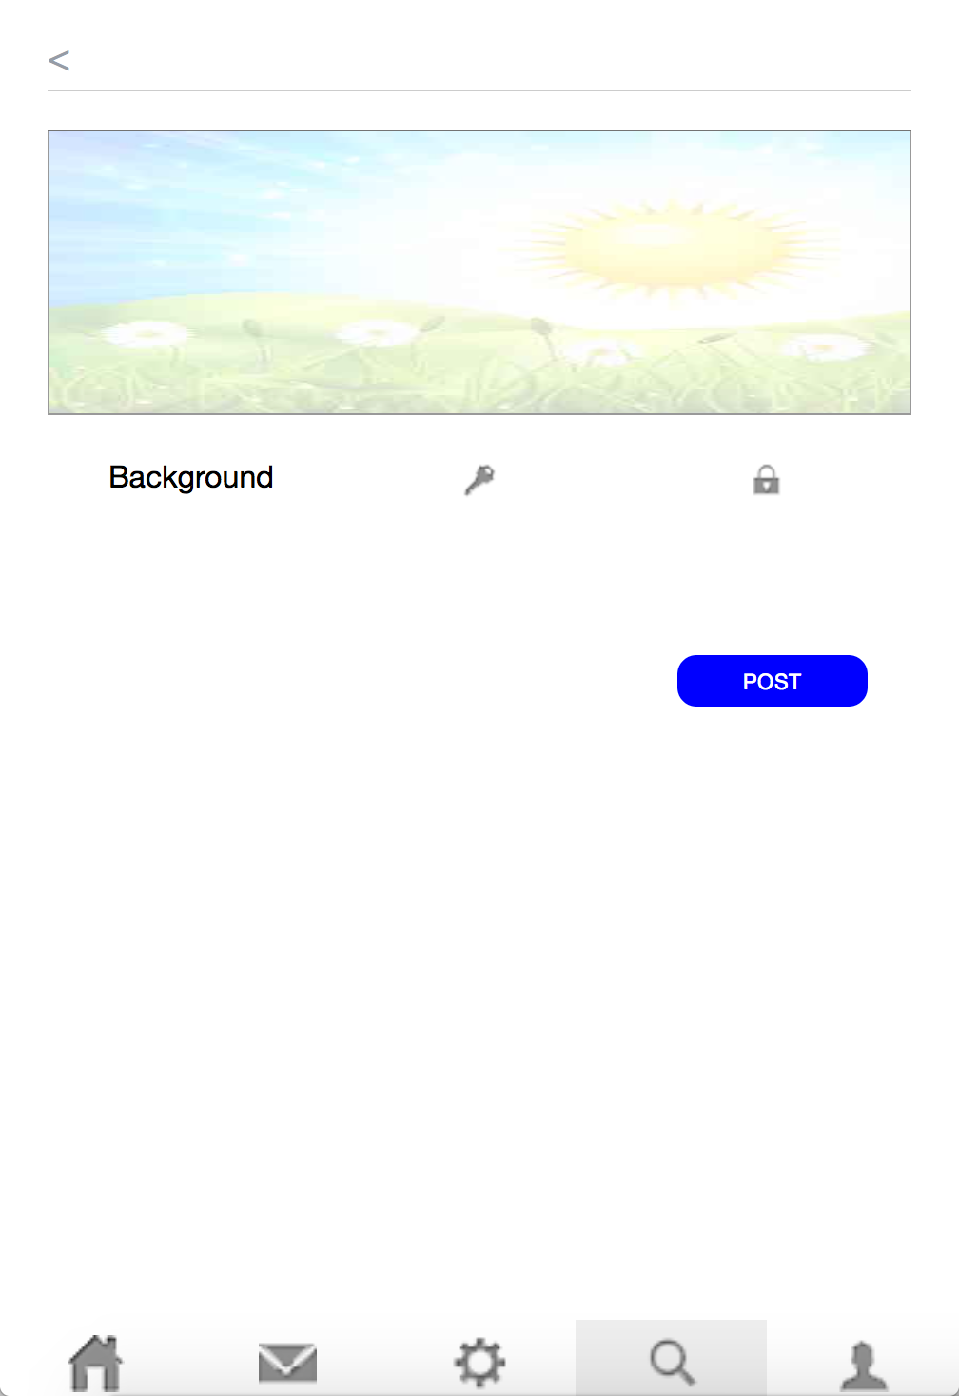
edit post issue(High)
Finding:The key and locker icons
don’t explain the functions under
them, the line under back button miss lead users to input words.
Users don’t know which button to click on. They confused about the key and locker icons. They assume that those two has some connections. But they can’t tell the exact function under the buttons.

Slide 16
Supporting evidence
Participant A:“I don’t understand what these mean. I don’t understand the what functions of these buttons are.”
Participant B: audio
Recommendation
Key supposes to express the function of changing font, change the icon to “Aa” will work better. And change the background to picture icon in order to make them neater.

Slide 17
post unclear Issue(High)
Finding:In the post, we suppose to let picture be the background. But it turns out that picture is messed up with the words, which is very unclear.

Slide 18
Supporting evidence
Participant A:“Some parts of the pictures are hidden behind the words. Well, it’s not that big a problem, but makes me feel hardtop try recognizing what the picture is showing.”
Participant B:audio
Recommendation
Separating the picture and the words. Put picture elsewhere. Or thinking of changing the font, size and color of the words to make it more obvious.

Slide 19
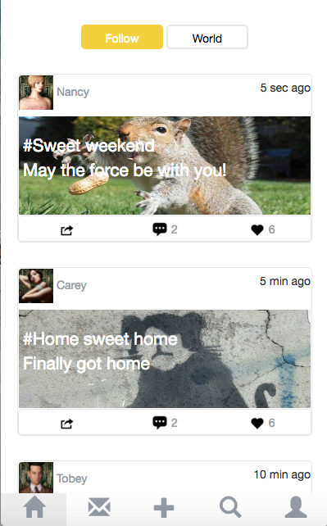
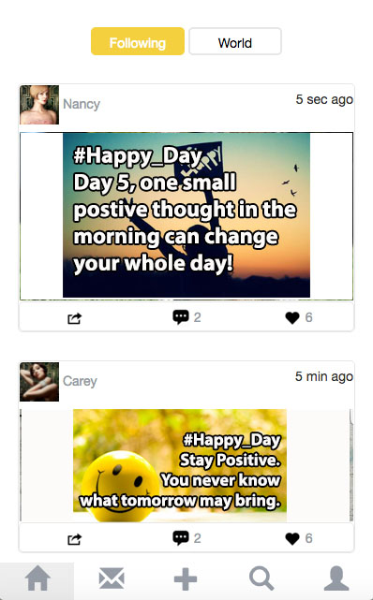
-confusing “following”& “world”
-too many pets pictures
-stretched pictures
-function of topics with “#” is not clear
-use “following” to represent the page that contains all the posts posted by the people the user is following
-change pictures and topics to not pet-related posts
-adjust the size of the picture and the style of the words to something easy-to-read
-use under score to connect every word in a topic

Slide 20
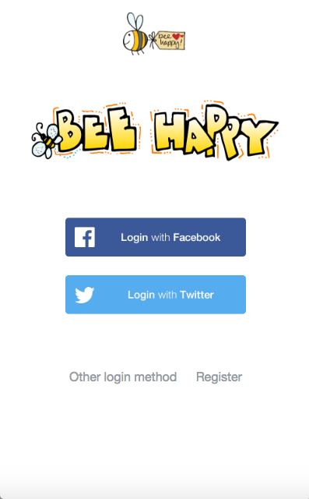
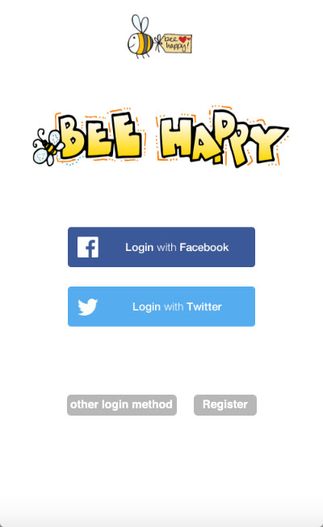
-“other login method” and “register” are not that easy-to-find for some participants.
-add background color to the “other login method” and “register” buttons

Slide 21
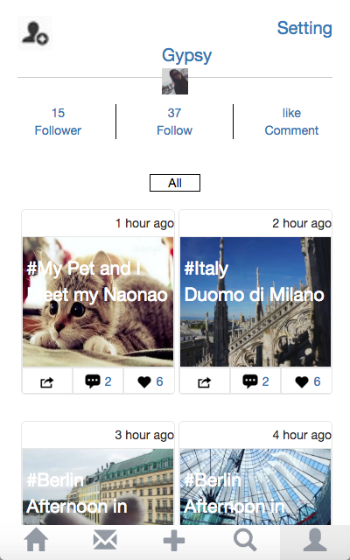
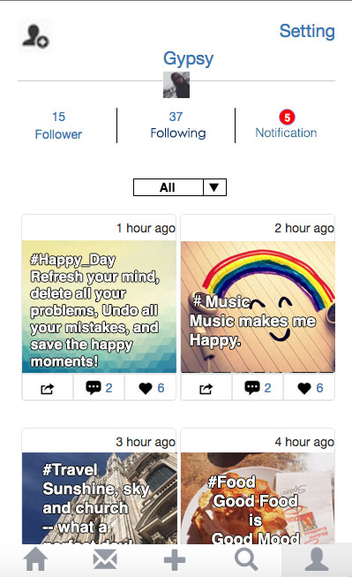
“Follow” is not clear
“like comment” is not clear
“All” is not obvious
-change “follow”to “following”
-add “notification”
-add arrow to “All”

Slide 22
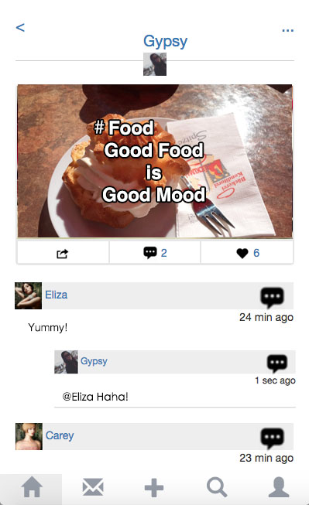
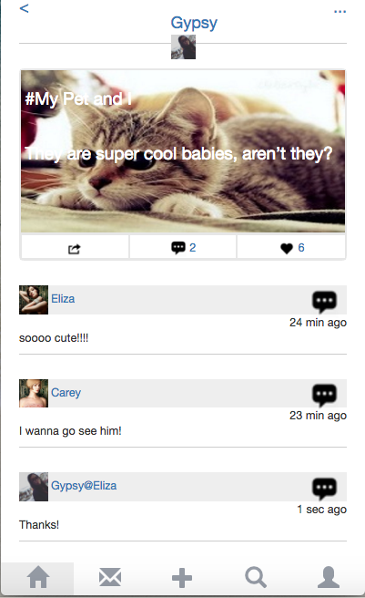
-make the word style more obvious
-change the position of the reply of a comment
-words are not easy to read on this picture
-the person is replied to is not clear

Slide 23
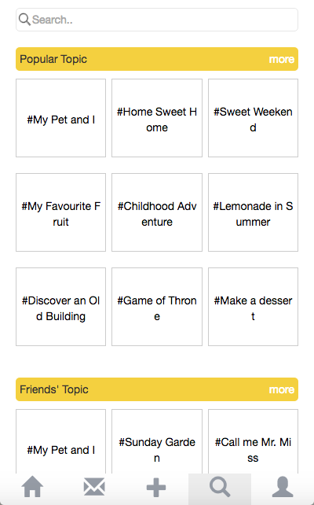
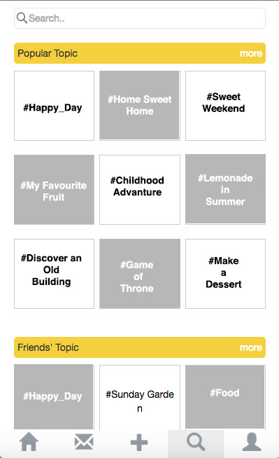
-words are not parted any more
-use two different colors to define different topics
-words are parted
-all the topics look all the same

Slide 24
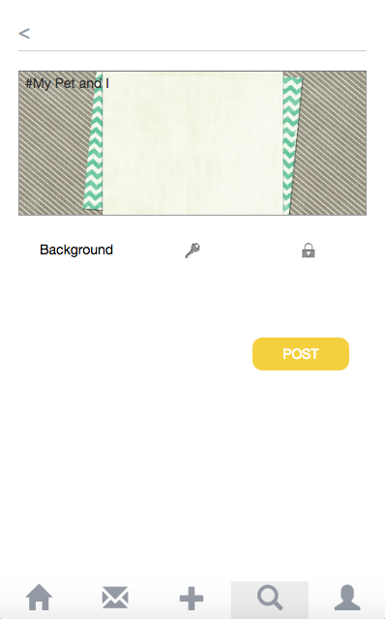
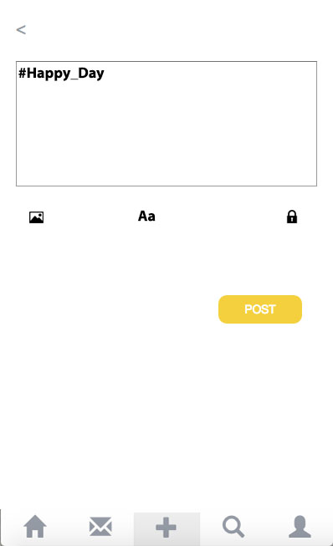
-do not know what this page is doing
-the top line has no title on it
-do not know what the key is doing
-the form of the buttons is not unified
-do not know the background could be changed
-the “search” button is lighten
-delete the top line
-change all the buttons to icons
-lighten the plus sign

Slide 25
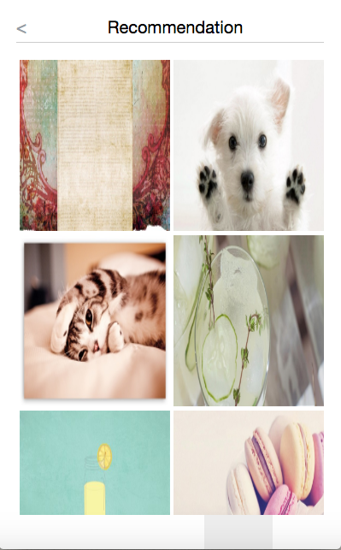

-add words to let users know that they can choose a background picture
-do not know the picture could be chosen

Slide 26
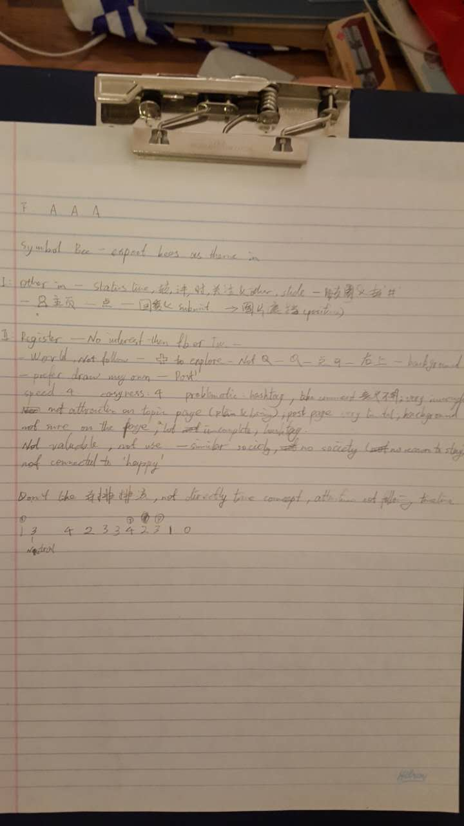
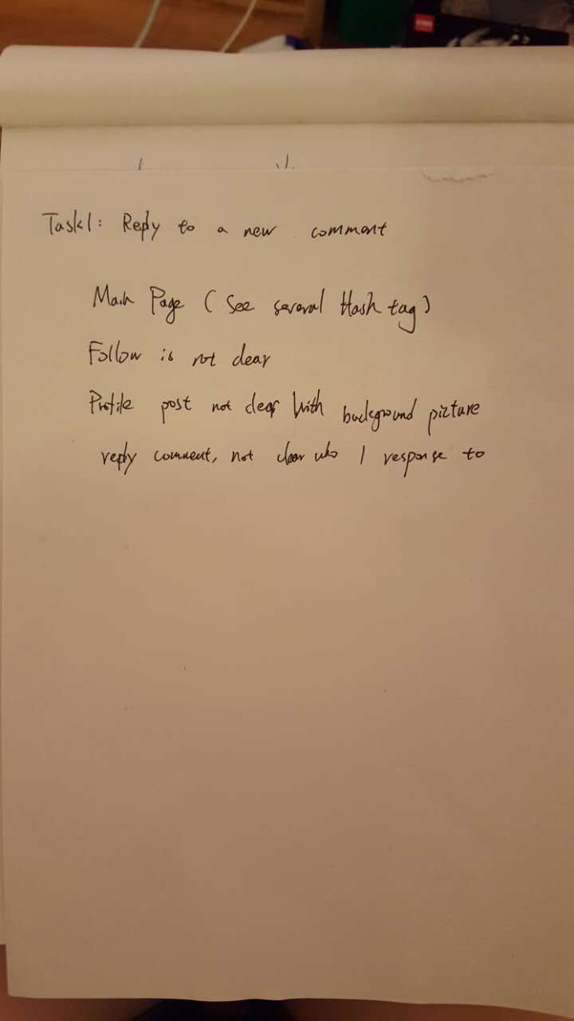
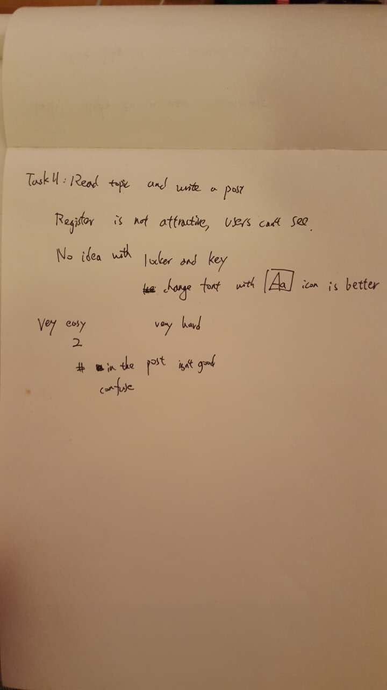
Appendix
Pictures of Notes:
By Sue By Jasmine

Slide 27
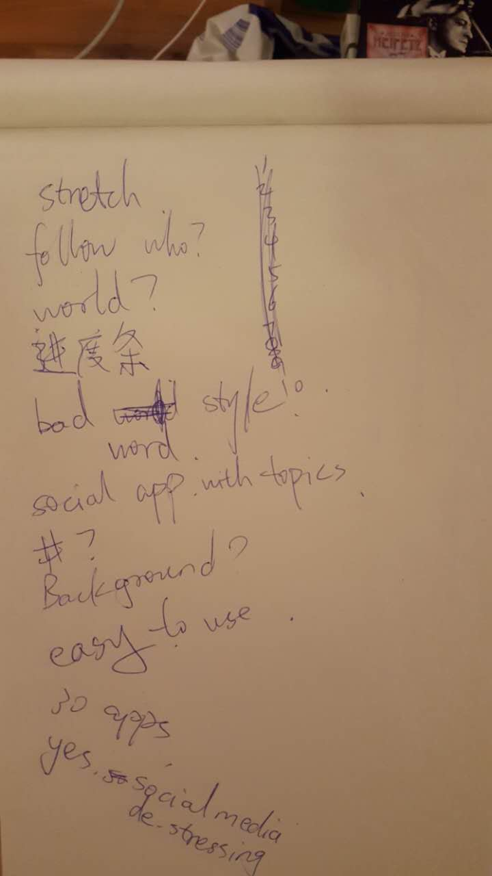
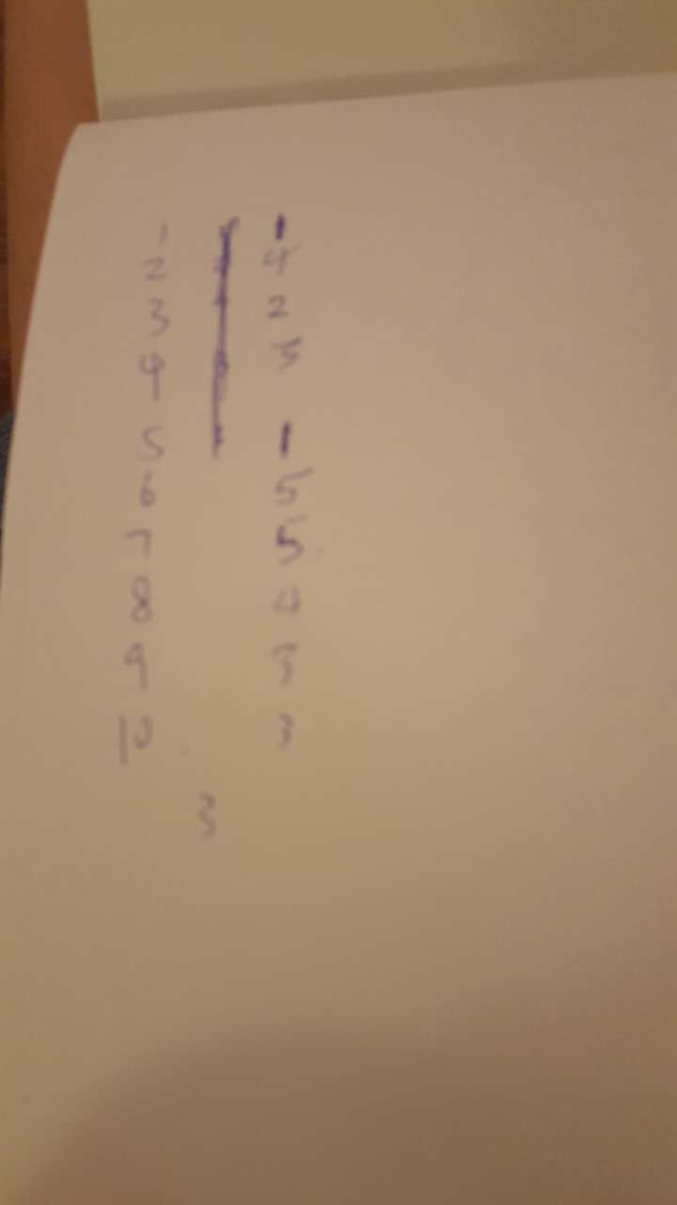
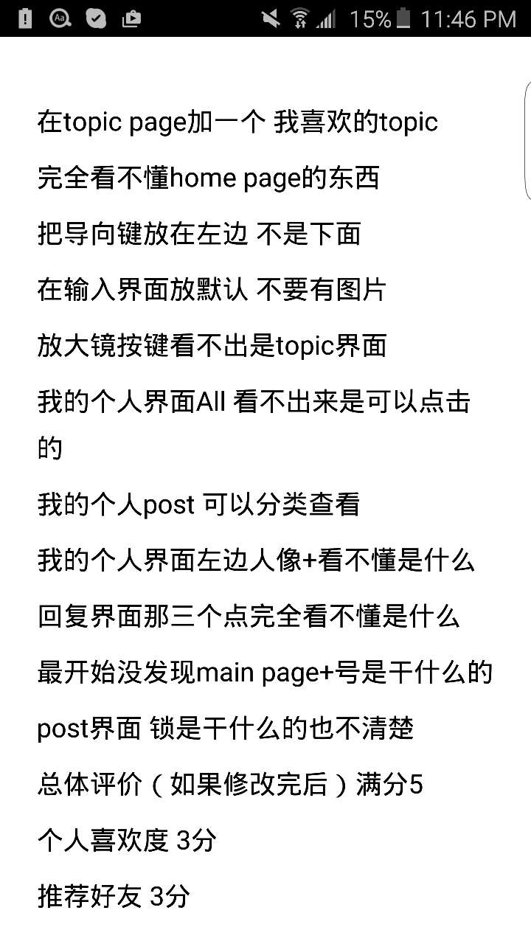
By Gypsy By Jervis

Slide 28
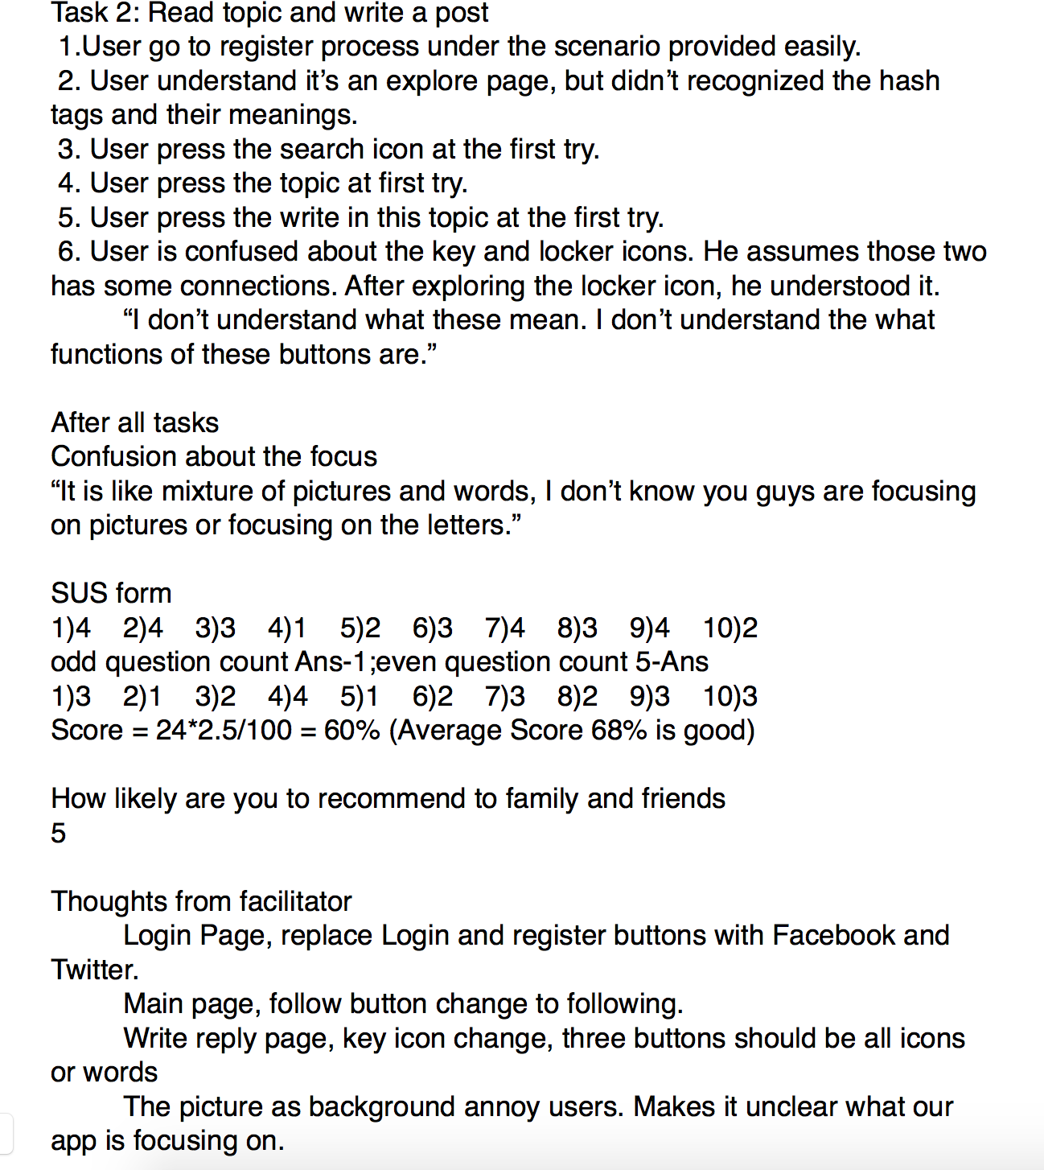
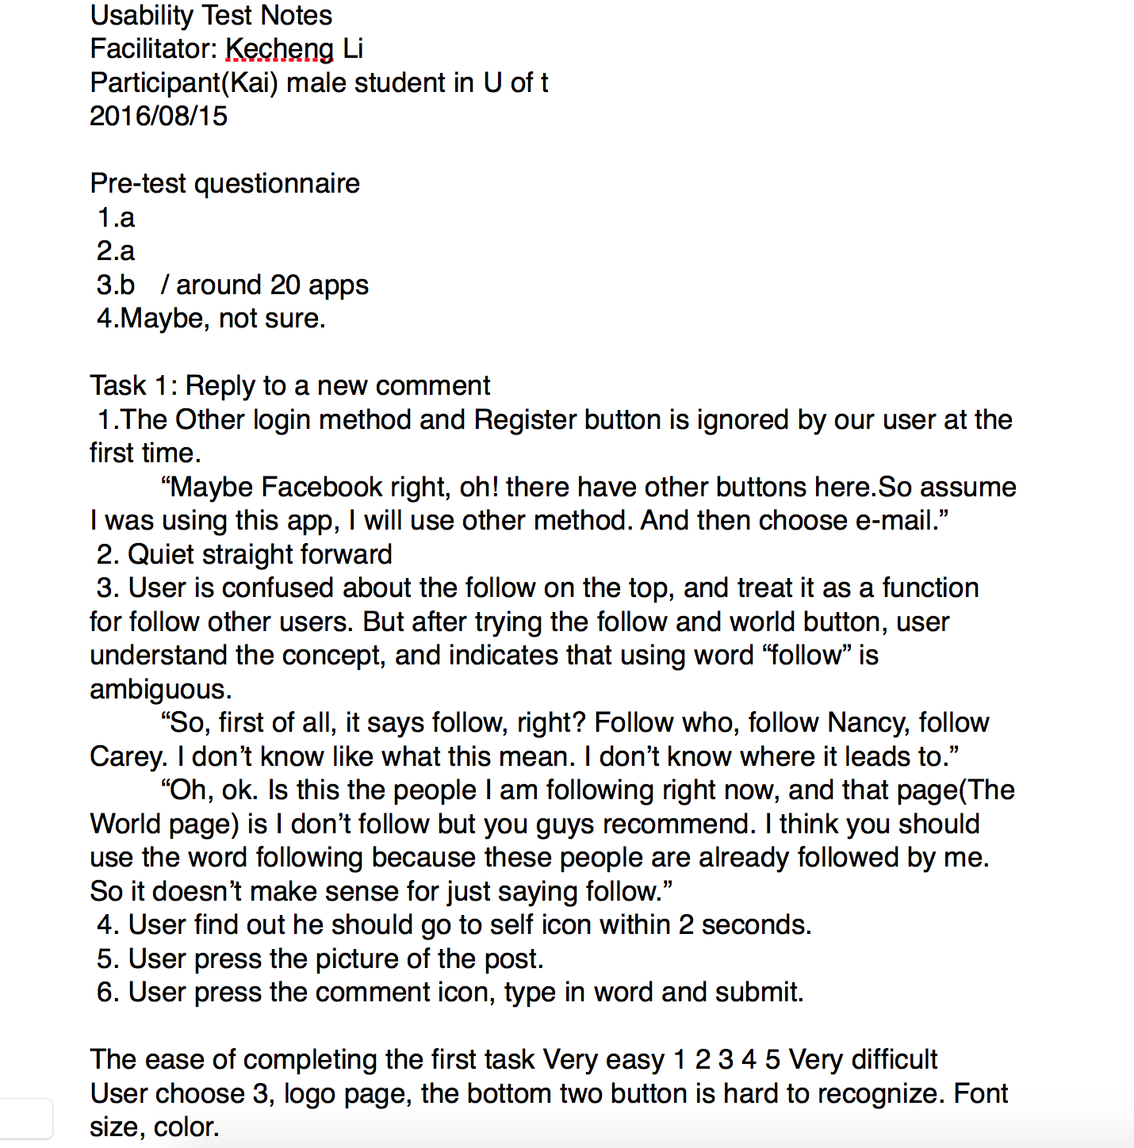
By Barry

